Slide 1
Safety Reporting in Global Clinical Trials Maximizing Compliance, Minimizing Costs
September 27, 2018
Kendra Hayden/Steven Beales

Slide 2

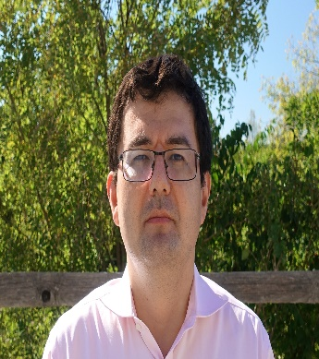
Our WCG Safety Letter Distribution Experts
Kendra Hayden
Current Role: Business Transformation Program Lead
Former Roles:
Business Sponsor – Clinical Trial Safety Portal
Global Process Owner – Safety Document Distribution
Clinical Operations Process and Safety Leader
Regional Compliance and Training Head
“Transforming global safety reporting since 2006”. Kendra has spent the last 12 years of her career in Safety Document Distribution. Kendra was the Lead Business Sponsor at Roche and process owner where she applied her expertise in global reporting and workflow transformation for both insourced and outsourced studies.
Steven Beales
Current Role: SVP, Market Owner, Safety Solutions
Former Roles:
Solution Architect, Clinical Trial Safety Portal
Solution Lead, Roche-Genentech, Celgene, Daiichi Sankyo Safety Portals
SME, Safety Distribution Country Rules
Chief Architect, 3 of top 6 US AMC CTMS
“Helping sponsors optimize global safety reporting since 2009”. Steven has spent his entire career in safety and clinical trials technology and is industry recognized as an expert in Pharmacovigilance and Safety Reporting. He is passionate about patient safety and speeding drug approval with bullet-proof compliance, while dramatically reducing operational cost and site burden. He led the development of the SadfetyPortal project with Roche and is responsible for the development of the commercial technology.

Slide 3
Disclaimer
The views and opinions expressed in this presentation and any related discussion(s) are solely those of the individual presenter(s) and may not express the views of and opinions of WCG or Roche.
Notes:
Kristy to mention ‘Obligatory Disclaimer’

Slide 4
Safety Reporting in Global Clinical Trials
Topics
Why is Safety reporting a problem?
Why is it important to address now?
How can costs be better managed?
How can compliance be improved?
Q&A

Slide 5
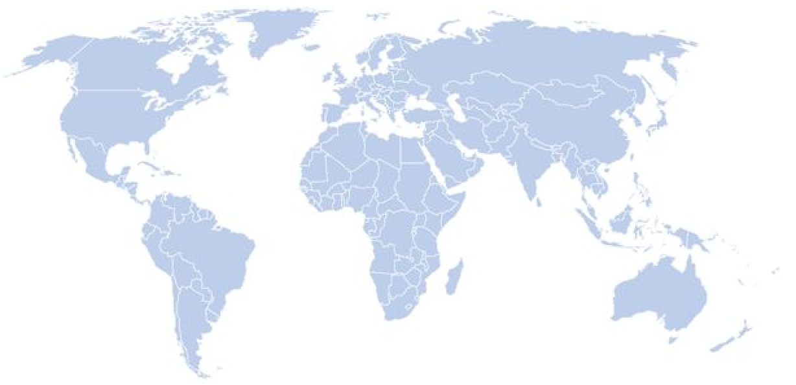
Why is Safety Reporting a problem?
Clinical Trials are complex!
Multiple countries
IMP/IP
Reference Safety Information
Multicompound
Unclear Regulatory Environment
Global & local teams
Multiple partners
Multiple interpretations
Over distribution
Fragmented process
Marketing Status
Combinations
Lack of Global Harmonization
Unclear rules
Accountability
Consistency and application
Overburden sites with data but not the wisdom needed to manage patient safety
Notes:
Lack of global harmonization
Unclear rules
Is there a global rule that all countries comply with
Accountability
Who is accountable for defining or interpreting what local law is
Consistency and application
How do you keep everyone trained and informed
How do you apply these rules or decisions once made across all countries and sites
Result of over distribution
Fragmented process
Is there a global rule that all countries comply with
Multiple interpretations of local law
Often would send everything “just in case”
Study level distribution
We work with large number of study teams, and partners and often they took it upon themselves to provides sites with safety information
Our sites on average are doing 3-4 studies often with the same compounds
Resources
Sites and IRBs
Sorting out the multiple documents and why there are discrepancies
IRB submissions, communicating with other site staff, archiving and tracking
Study Teams
Expending resources to ensure sites and IRB got the necessary information
Insourced and outsourced studies
Monitors
Tracking, reconciliation and archiving
Managing gaps manually
Quality Oversight
Accountabilities
Who is accountable to ensure sites and IRB/IEC are receiving the right information
Fragmented process
++ resources need to oversee a process that is managed multiple ways
Addressing gaps
Evidence of compliance

Slide 6

Why is it important to address now?
In the attempt to comply with unclear rules, over distribution occurs
Report information sites do not need or want
Masking significant safety information by volume
Administrative aspects versus content
Need Study teams and sites to focus on what they do best
Because it is not getting any easier!
Did you know? Currently in the US, Adverse drug reactions are the 4th leading cause of death.

Slide 7
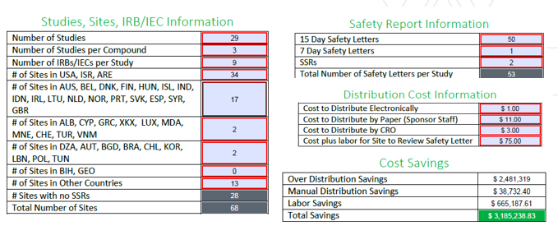
How can costs be better managed?
Understand drivers for cost associated to safety reporting
Currently the industry averages for costs associated for distributing safety reports are $35 – $75
Contracts and SMPs
Studies and sites
Countries
Studies per compound
Resource consumption
Country Rules
Cost Calculator
Notes:
Study teams typically accountable for defining rules and reporting safety information
Clinical trial sites typically participate in multiple studies with the same compound
Inconsistent application
Repeat payments for duplicate reports
Understand the nature of safety information
Develop Expert networks
Monitor and continual improvement
Inconsistent application of rules
Sites receive duplicate or different types of information (or none) for the same compound in different studies
Additional time needed to address administrative aspects
No standard cost model
Cost variance x – x

Slide 8

How can costs be better managed?
Adopt a holistic approach to safety reporting based on compound level reporting
Study 1
Study 2
Study 3
Study 1,2,3
Study Level
Multiple teams defining rules increase fragmentation and risk
Compound Level
Global Rules per country controlled process
Single costs incurred is “shared” across all studies using the compound
Cost incurred by all studies for same report to same recipient(s)
Notes:
Study teams typically accountable for defining rules and reporting safety information
Clinical trial sites typically participate in multiple studies with the same compound
Inconsistent application
Repeat payments for duplicate reports
Understand the nature of safety information
Develop Expert networks
Monitor and continual improvement
Inconsistent application of rules
Sites receive duplicate or different types of information (or none) for the same compound in different studies
Additional time needed to address administrative aspects
No standard cost model
Cost variance x – x

Slide 9
How can compliance be improved?
Understand how safety reporting aligns with the E2E process landscape and infrastructure
SAE reporting, case processing, safety reporting
Regulatory, PV, clinical operations processes and accountabilities
Investigator
Sponsor
Investigator/Ethics
SAE reporting
AE reporting
ICSR Clinical Trial
Spontaneous Reports
Reference Safety Information
Safety Database
Local law
“Dear Investigator Letters”
Annual updates
Health Authorities
Line Listing
SUSAR
Urgent Safety Measure
24 hrs of becoming aware
CRF/EDC

Slide 10

How can compliance be improved?
Develop the Safety Reference Model for safety reporting
Define accountabilities and roles
Sponsor/CRO, Drug Safety, Clinical Operations
Communication with Ethics - Investigator vs Sponsor
Safety Document types and characteristics
Documents Types
SUSAR, Aggregate reports (SSR), RSI/IBs, DIL/USM
Document Characteristics
Causality, Protocol, Domestic
7 Day and Follow-Up reports
Comparators and Non-Sponsor IMPs
Defined rules for each country
Decision Maker
Expert Networks
Take action and define the rules where none exist.
Notes:
Focus on what you can do and take action
Monitor regulatory environment
Intelligent flexible systems
Alignment of process and systems

Slide 11
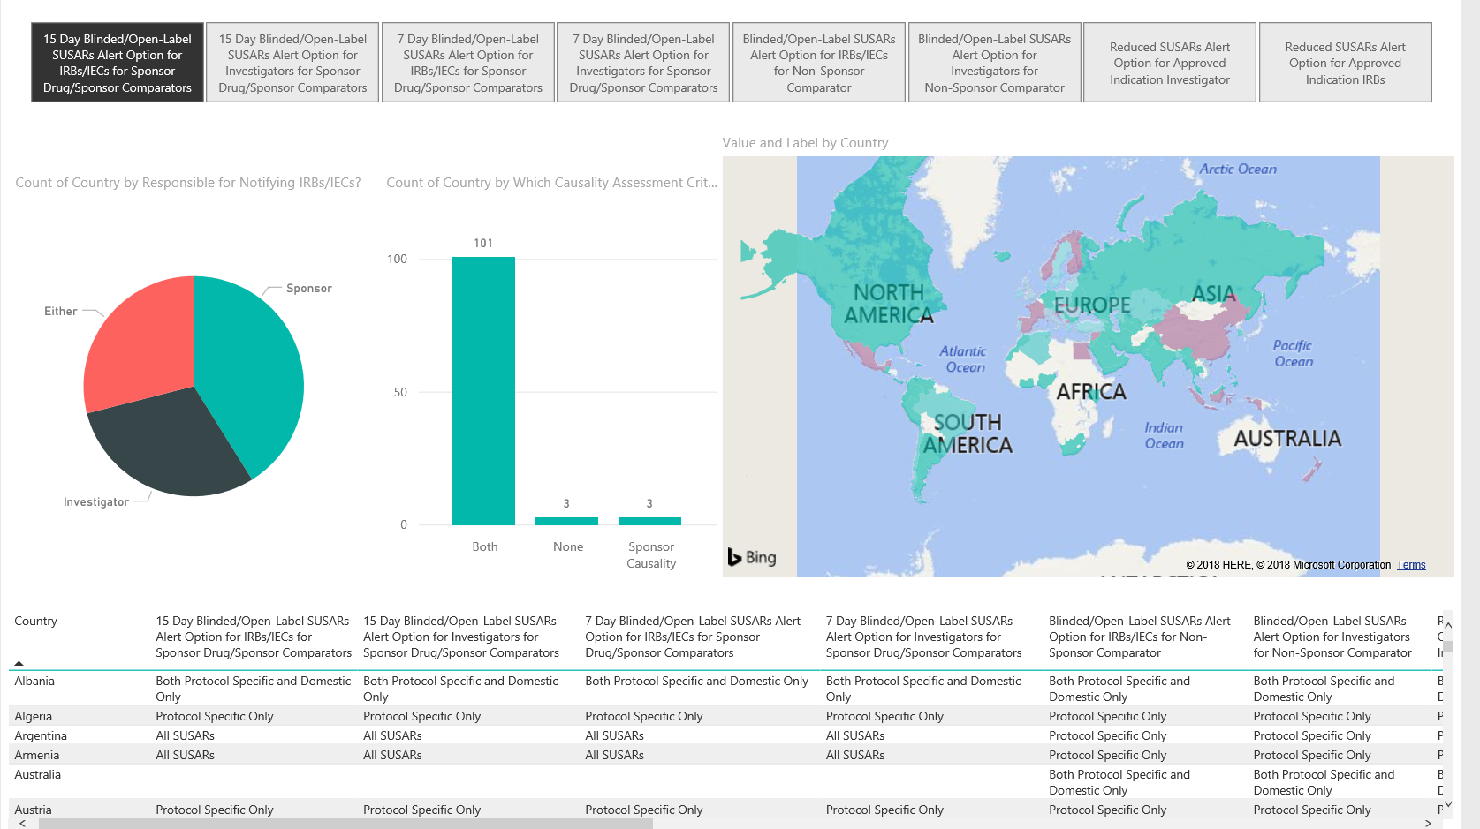
Safety Reference Model
Document Type Characteristics
Causality - In some countries, only events attributed to the IMP by the Sponsor require reporting.
Can account for 10-50% of all reports depending on the Sponsor Drug Safety Practices
Build in our lessons learned!
Enhance precision distribution
“Unanticipated Problem”
Notes:
Develop expert networks

Slide 12

How can compliance be improved?
Transform your data into knowledge
Incorporate analytics to understand your data
What do you need to know?
Quality objectives
Inspections/Regulator
Why is it important?
Confidence to withstand regulatory scrutiny
Identify strengths and weaknesses
Monitoring and Governance
Decision making
Mitigation plans
Process alignment
Monitor and Prepare for change
Notes:
Understand the nature of safety information
Develop Expert networks
Monitor and continual improvement

Slide 13
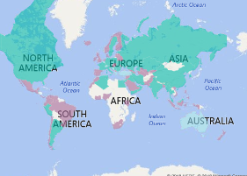
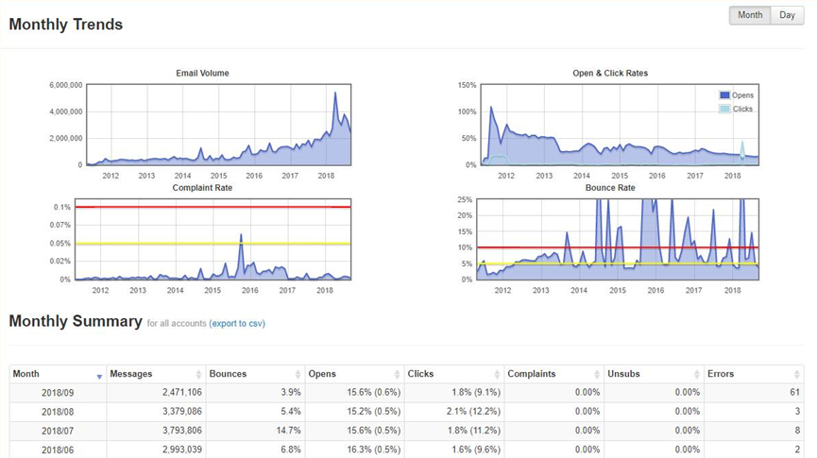
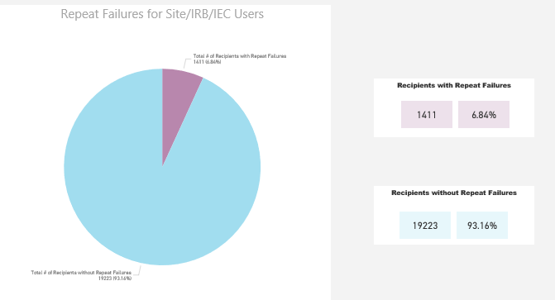
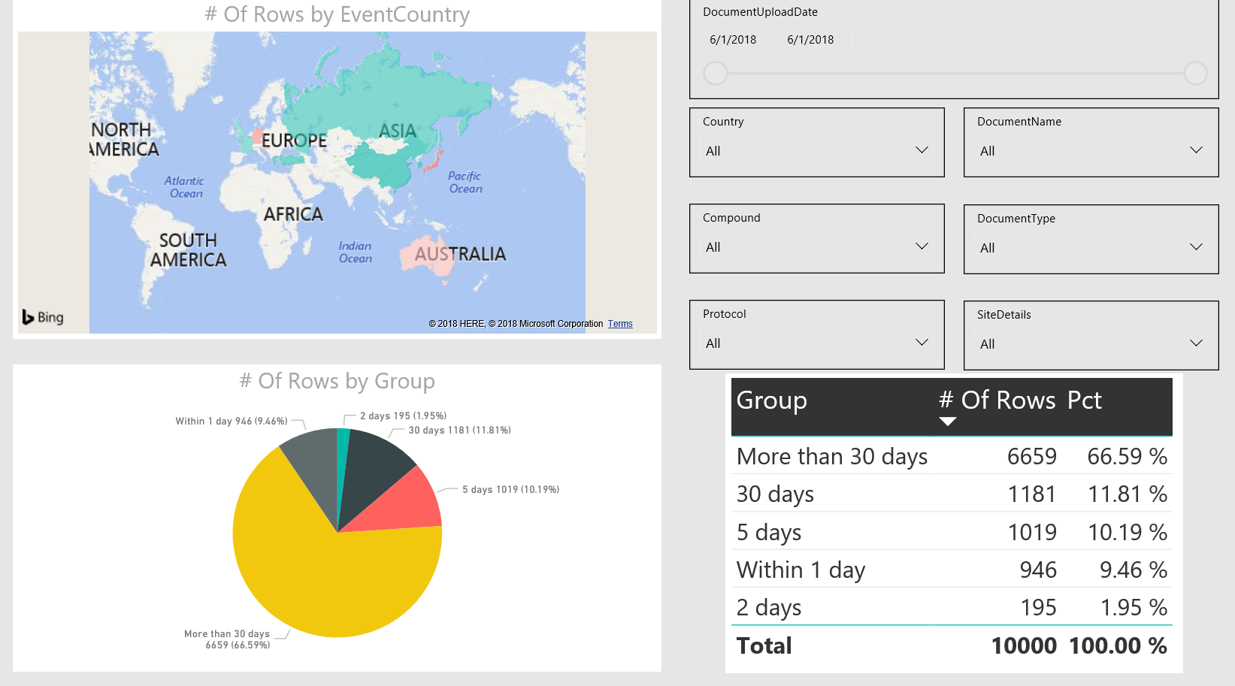
Safety Reporting Dashboards
End to end oversight
Country Rules and Amendments
Volume and target audience
Identify risk
How is the information being consumed?
Notes:
Understand the nature of safety information
Develop Expert networks
Monitor and continual improvement

Slide 14
Safety Reporting in Global Clinical Trials
Managing compliance and controlling costs will drive…
Global Harmonization
Clear Rules
Defined Accountability
Consistent Application
Precision Distribution
Standardized Process
“Codified” Country Rules
Compound Level Distribution
Unburdened Resources
Sites/IRB/IECs
Study Teams
Monitors
Quality Oversight
Process and Procedures
Transparency and Monitoring
Compliance
Notes:
Share with you the methodology and background that went into defining the Safety Portal and its support structure. Step 1 was to implement basic process management methodology (six sigma) to identify the problems and put in place the right solution.
Global Harmonization –need to look at your own internal processes and understand how safety letters are produced before sorting out how to make them available and then define the rules, accountabilities and how to apply it consistently and for which studies.
Precision Distribution – defined the process that will be applied and how it fit in with other process, took control of country rules and defined them based on our understanding of safety letter characteristic and feedback we have been receiving over the last several years and lastly called out that the management of a compound safety profile is not a study accountability but a compound level and as such should be managed that way(means they get one alert no matter how many studies or partners they work with!). Sites work with so many different teams and managing it within a study subjects them to over distribution and fragmentation from the start.
Unburden Resources – focused on the roles who use both produce safety letters, receive safety letters and those accountable for site and study management, incorporated there feedback and tried to make it easier and reducing the work they need to do – made training easier and shorter and role based, made email alerts recipient friendly (just tell me what I need to know so I can decide what to do), made reports available that help you answer questions you need answers to and when and how to use them. We also looked at single sign on with other systems, and simplified archiving too for a site and built in better control on how to stop safety letters for sites that have no active patients.
Quality Oversight – Built in along with the design and included oversight of the common pain points through metrics and dashboard reporting. As part of the governance and health checks, quality oversight activities also ensure the sustainability of the solution and takes into account feedback. In addition, ensured compliance by putting in controls on country rules and role based training.

Slide 15
Q& A Session
Kendra Hayden
Current Role: Business Transformation Program Lead
Former Roles:
Business Sponsor – Clinical Trial Safety Portal
Global Process Owner – Safety Document Distribution
Clinical Operations Process and Safety Leader
Regional Compliance and Training Head
“Transforming global safety reporting since 2006”. Kendra has spent the last 12 years of her career in Safety Document Distribution. Kendra was the Lead Business Sponsor at Roche and process owner where she applied her expertise in global reporting and workflow transformation for both insourced and outsourced studies.
Steven Beales
Current Role: SVP, Market Owner, Safety Solutions
Former Roles:
Solution Architect, Clinical Trial Safety Portal
Solution Lead, Roche-Genentech, Celgene, Daiichi Sankyo Safety Portals
SME, Safety Distribution Country Rules
Chief Architect, 3 of top 6 US AMC CTMS
“Helping sponsors optimize global safety reporting since 2009”. Steven has spent his entire career in safety and clinical trials technology and is industry recognized as an expert in Pharmacovigilance and Safety Reporting. He is passionate about patient safety and speeding drug approval with bullet-proof compliance, while dramatically reducing operational cost and site burden. He led the development of the SadfetyPortal project with Roche and is responsible for the development of the commercial technology.

Slide 16

Thank You

